Slide 1
Geometry 5-1
Midsegments of Triangles

Slide 2
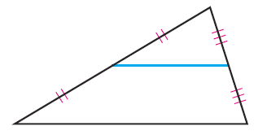
Vocabulary
Midsegment – The segment connecting the midpoint of the sides of a triangle

Slide 3
Investigation
Get your supplies
2 pieces of patty paper
Straight Edge

Slide 4
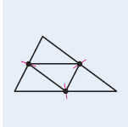
Midsegment Investigation
Patty Paper
Draw a large triangle on a piece of patty paper
Fold/Pinch each of the sides to find the midpoint
Connect all three midpoints, so you have a triangle drawn with four triangles inside

Slide 5
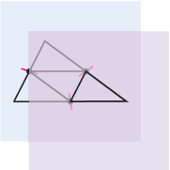
Midsegment Investigation
Use a second sheet of patty paper to copy the entire triangle, including the midsegments
Compare all four triangles
What conclusions can you draw?

Slide 6
Midsegment Conjecture
The three midsegments of a triangle divide it into four congruent triangles

Slide 7
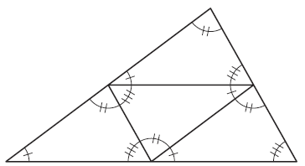
Midsegment Investigation
Mark all congruent angles in the triangles.
What conclusions can be made about the direction (slope) of the two highlighted lines?

Slide 8
Midsegment Investigation
Mark all congruent angles in the triangles.
What conclusions can be made about the length of the two highlighted lines?

Slide 9
Triangle Midsegment Conjecture
A midsegment of a triangle is parallel to the third side, and half the length of the third side

Slide 10
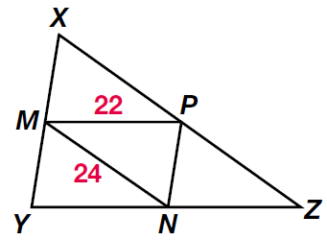
Practice Problems

Slide 11
Practice Problems

Slide 12
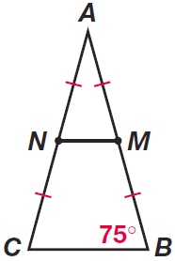
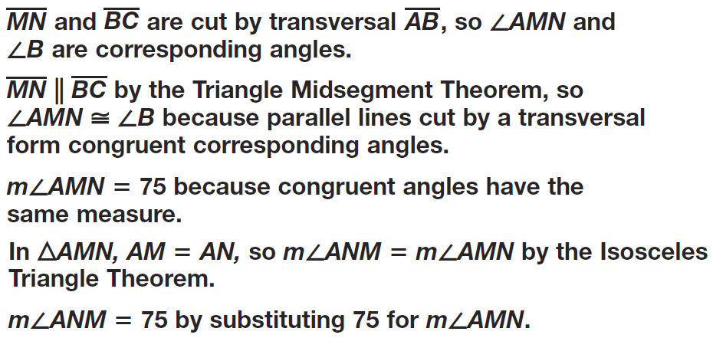
Practice Problems

Slide 13
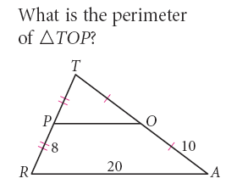
Practice Problems

Slide 14
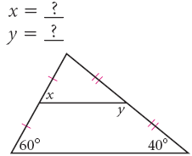
Practice Problems

Slide 15
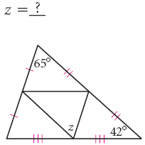
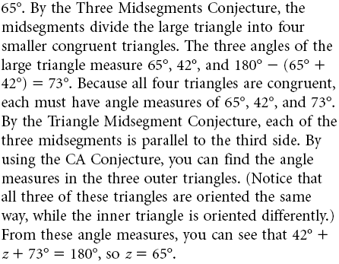
Practice Problems

Slide 16
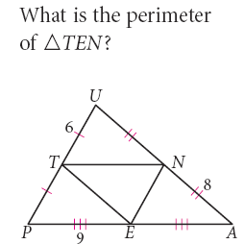
Practice Problems

Slide 17
Homework
Pages 246 – 248
16,17, 20, 22-25, 27-30, 47-49

