Slide 1
Geometry 1-2
Points, Lines, and Planes
Notes:
Supplies: Rulers, Paper, Color Pencils

Slide 2
Vocabulary
Point – No size, only location. Represented with a dot. Symbol = Capital Letter
Line – Continuous arrangement of infinitely many points, no width, infinite length. Symbol = line with arrows over letters

Slide 3
Vocabulary
Plane – Length and width, but no thickness. A flat surface that extends infinitely along its length and width. Symbol = script capital letter.

Slide 4
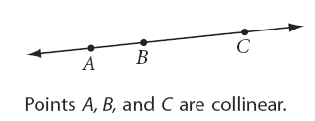
Vocabulary
Collinear – Two or more points along the same line.

Slide 5
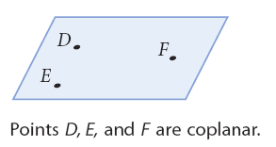
Vocabulary
Coplanar – Items on the same plane.

Slide 6
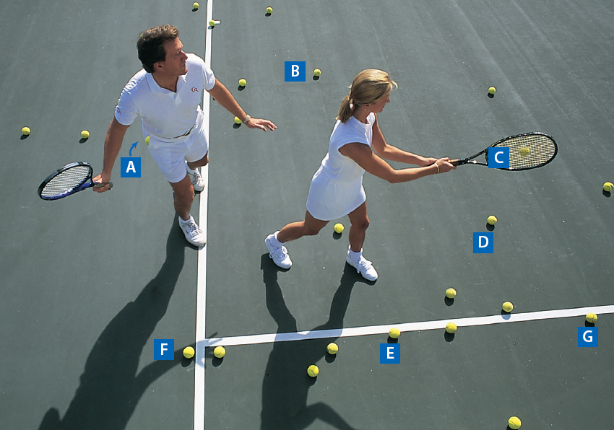
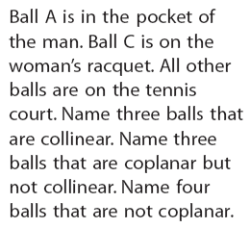
CoPlanar

Slide 7
Vocabulary
Line Segment – Consists of two points called endpoints. Symbol = line without arrows over letters.

Slide 8
Vocabulary
Postulate or Axiom – An accepted statement of fact

Slide 10
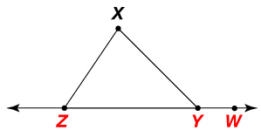
Example
In the figure below, name three points that are collinear and three points that are not collinear.
Points Y, Z, and W lie on a line, so they are collinear.
Any other set of three points do not lie on a line, so no other set of
three points is collinear.
For example, X, Y, and Z and X, W, and Z form triangles and are not collinear.

Slide 11
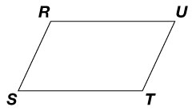
Example
Name the plane shown in two different ways.
You can name a plane using any three or more points on that plane
that are not collinear. Some possible names for the plane shown are
the following:
plane RST
plane RSU
plane RTU
plane STU
plane RSTU

Slide 12
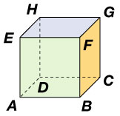
Example
Use the diagram below. What is the intersection of plane HGC and plane AED?
As you look at the cube, the front face is on plane AEFB, the back
face is on plane HGC, and the left face is on plane AED.
The back and left faces of the cube intersect at HD.
Planes HGC and AED intersect vertically at HD.

Slide 13
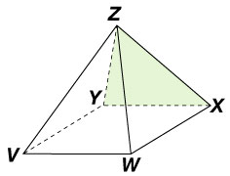
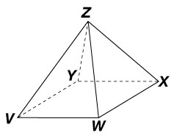
Example
Shade the plane that contains X, Y, and Z.
Points X, Y, and Z are the vertices of one of the
four triangular faces of the pyramid. To shade
the plane, shade the interior of the triangle
formed by X, Y, and Z.

Slide 14
Postulates

Slide 15
Postulates

Slide 16
Postulates

Slide 17
Postulates

Slide 18
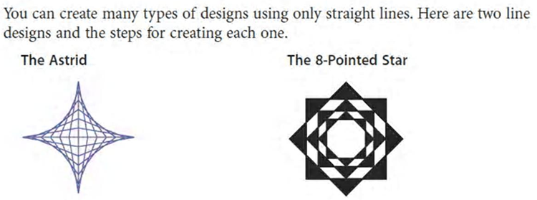
Ruler Practice

Slide 19
Ruler Practice

Slide 20
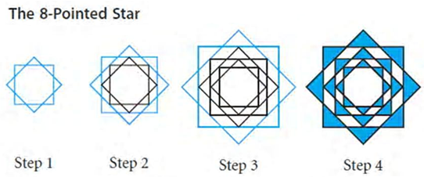
Ruler Practice

Slide 21
Ruler Practice

Slide 22
Homework
Pages 13 - 16
7, 8, 10, 15, 24, 32, 36, 47 – 51, 60 – 65, 67, 68, 93

