Slide 1
Statistics 18
Sampling Distribution

Slide 2
The Central Limit Theorem for Sample Proportions
Rather than showing real repeated samples, imagine what would happen if we were to actually draw many samples.
Now imagine what would happen if we looked at the sample proportions for these samples.
The histogram we’d get if we could see all the proportions from all possible samples is called the sampling distribution of the proportions.
What would the histogram of all the sample proportions look like?

Slide 3
The Central Limit Theorem for Sample Proportions
We would expect the histogram of the sample proportions to center at the true proportion, p, in the population.
As far as the shape of the histogram goes, we can simulate a bunch of random samples that we didn’t really draw.
It turns out that the histogram is unimodal, symmetric, and centered at p.
More specifically, it’s an amazing and fortunate fact that a Normal model is just the right one for the histogram of sample proportions.

Slide 4
Modeling the Distribution of Sample Proportions
Modeling how sample proportions vary from sample to sample is one of the most powerful ideas we’ll see in this course.
A sampling distribution model for how a sample proportion varies from sample to sample allows us to quantify that variation and how likely it is that we’d observe a sample proportion in any particular interval.
To use a Normal model, we need to specify its mean and standard deviation. We’ll put µ, the mean of the Normal, at p.

Slide 5
Modeling the Distribution of Sample Proportions
When working with proportions, knowing the mean automatically gives us the standard deviation as well—the standard deviation we will use is
So, the distribution of the sample proportions is modeled with a probability model that is

Slide 6
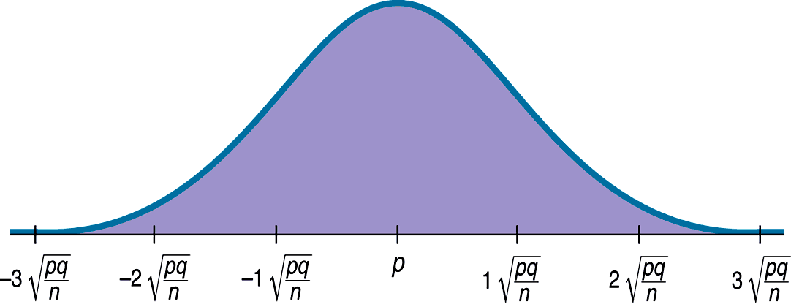
Modeling the Distribution of Sample Proportions
A picture of what we just discussed is as follows:

Slide 7
The Central Limit Theorem for Sample Proportions
Because we have a Normal model, for example, we know that 95% of Normally distributed values are within two standard deviations of the mean.
So we should not be surprised if 95% of various polls gave results that were near the mean but varied above and below that by no more than two standard deviations.
This is what we mean by sampling error. It’s not really an error at all, but just variability you’d expect to see from one sample to another. A better term would be sampling variability.

Slide 8
How Good Is the Normal Model?
The Normal model gets better as a good model for the distribution of sample proportions as the sample size gets bigger.
Just how big of a sample do we need? This will soon be revealed…

Slide 9
Assumptions and Conditions
Most models are useful only when specific assumptions are true.
There are two assumptions in the case of the model for the distribution of sample proportions:
The Independence Assumption: The sampled values must be independent of each other.
The Sample Size Assumption: The sample size, n, must be large enough.

Slide 10
Assumptions and Conditions
Assumptions are hard—often impossible—to check. That’s why we assume them.
Still, we need to check whether the assumptions are reasonable by checking conditions that provide information about the assumptions.
The corresponding conditions to check before using the Normal to model the distribution of sample proportions are the Randomization Condition, the 10% Condition and the Success/Failure Condition.

Slide 11
Assumptions and Conditions
Randomization Condition: The sample should be a simple random sample of the population.
10% Condition: the sample size, n, must be no larger than 10% of the population.
Success/Failure Condition: The sample size has to be big enough so that both np (number of successes) and nq (number of failures) are at least 10.
…So, we need a large enough sample that is not too large.

Slide 12
A Sampling Distribution Model for a Proportion
A proportion is no longer just a computation from a set of data.
It is now a random variable quantity that has a probability distribution.
This distribution is called the sampling distribution model for proportions.
Even though we depend on sampling distribution models, we never actually get to see them.
We never actually take repeated samples from the same population and make a histogram. We only imagine or simulate them.

Slide 13
A Sampling Distribution Model for a Proportion
Still, sampling distribution models are important because
they act as a bridge from the real world of data to the imaginary world of the statistic and
enable us to say something about the population when all we have is data from the real world.

Slide 14
The Sampling Distribution Model for a Proportion
Provided that the sampled values are independent and the sample size is large enough, the sampling distribution of is modeled by a Normal model with
Mean:
Standard deviation:

Slide 15
What About Quantitative Data?
Proportions summarize categorical variables.
The Normal sampling distribution model looks like it will be very useful.
Can we do something similar with quantitative data?
We can indeed. Even more remarkable, not only can we use all of the same concepts, but almost the same model.

Slide 16
Example
Of all cars on the interstate, 80% exceed the speed limit. What proportion of speeders might we see among the next 50 cars?

Slide 17
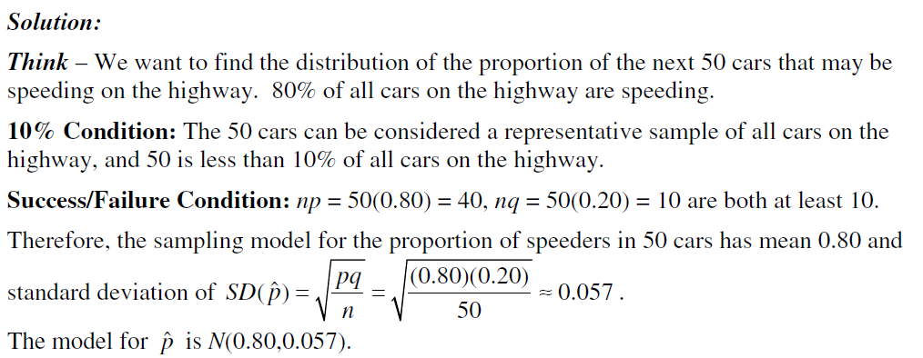
Example
Of all cars on the interstate, 80% exceed the speed limit. What proportion of speeders might we see among the next 50 cars?

Slide 18
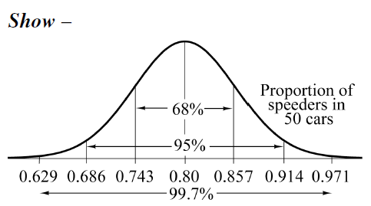
Example
Of all cars on the interstate, 80% exceed the speed limit. What proportion of speeders might we see among the next 50 cars?

Slide 19
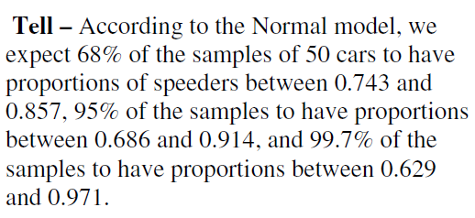
Example
Of all cars on the interstate, 80% exceed the speed limit. What proportion of speeders might we see among the next 50 cars?

Slide 20
Example
We don’t know it, but 52% of voters plan to vote “Yes” on the upcoming school budget. We poll a random sample of 300 voters. What might the percentage of yes-voters appear to be in our poll?

Slide 21
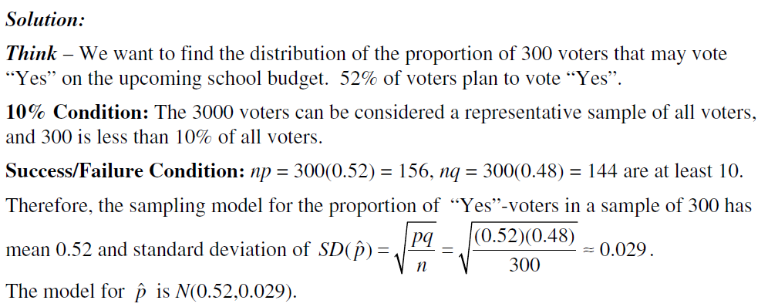
Example
We don’t know it, but 52% of voters plan to vote “Yes” on the upcoming school budget. We poll a random sample of 300 voters. What might the percentage of yes-voters appear to be in our poll?

Slide 22
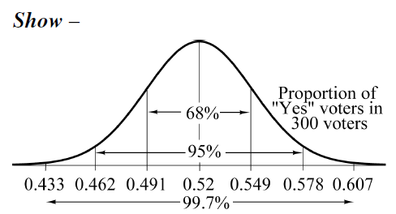
Example
We don’t know it, but 52% of voters plan to vote “Yes” on the upcoming school budget. We poll a random sample of 300 voters. What might the percentage of yes-voters appear to be in our poll?

Slide 23
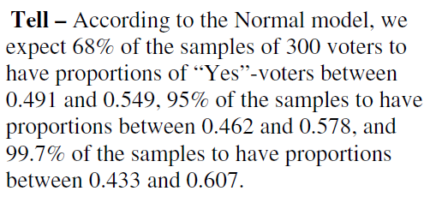
Example
We don’t know it, but 52% of voters plan to vote “Yes” on the upcoming school budget. We poll a random sample of 300 voters. What might the percentage of yes-voters appear to be in our poll?

Slide 24
Example
“Groovy” M&M’s are supposed to make up 30% of the candies sold. In a large bag of 250 M&M’s, what is the probability that we get at least 25% groovy candies?

Slide 25
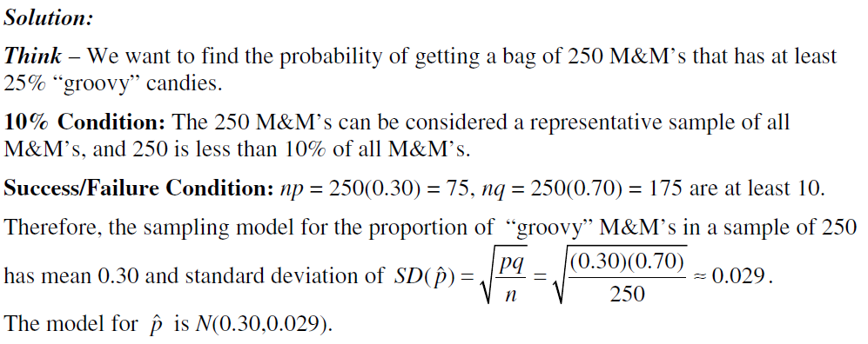
Example
“Groovy” M&M’s are supposed to make up 30% of the candies sold. In a large bag of 250 M&M’s, what is the probability that we get at least 25% groovy candies?

Slide 26
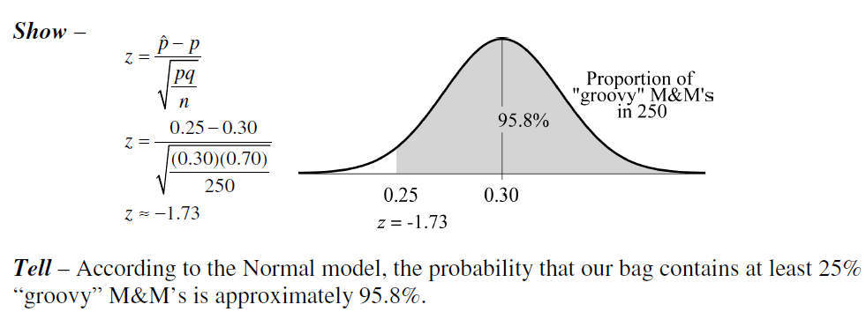
Example
“Groovy” M&M’s are supposed to make up 30% of the candies sold. In a large bag of 250 M&M’s, what is the probability that we get at least 25% groovy candies?

Slide 27
Example
“Groovy” M&M’s are supposed to make up 30% of the candies sold. In a large bag of 250 M&M’s, what is the probability that we get at least 25% groovy candies?

Slide 28
Simulating the Sampling Distribution of a Mean
Like any statistic computed from a random sample, a sample mean also has a sampling distribution.
We can use simulation to get a sense as to what the sampling distribution of the sample mean might look like…

Slide 29
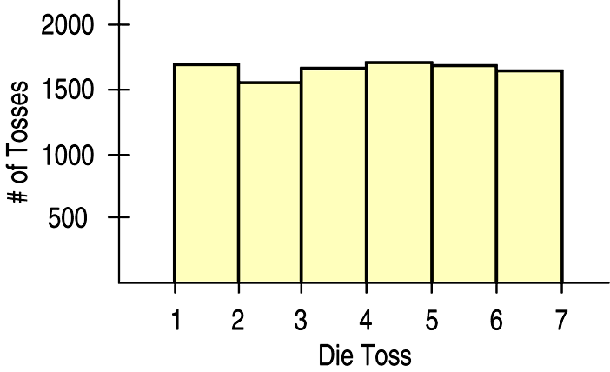
Means – The “Average” of One Die
Let’s start with a simulation of 10,000 tosses of a die. A histogram of the results is:

Slide 30
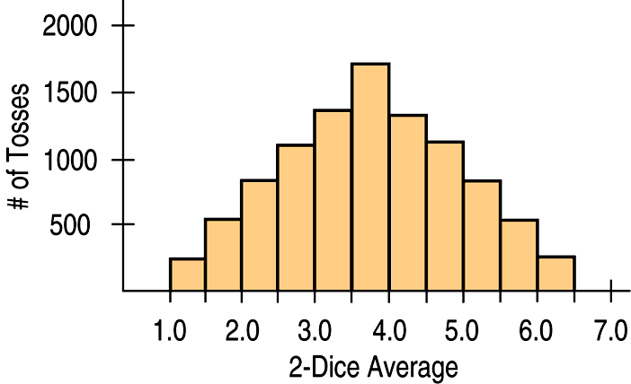
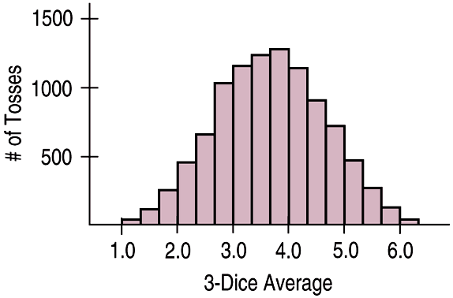
Means – Averaging More Dice
Looking at the average of two dice after a simulation of 10,000 tosses:
The average of three dice after a simulation of 10,000 tosses looks like:

Slide 31
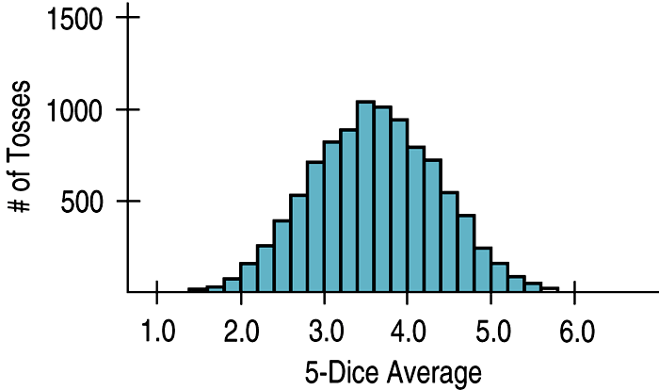
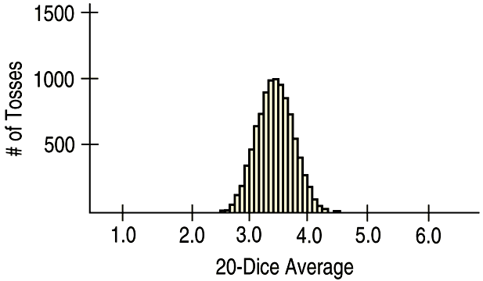
Means – Averaging Still More Dice
The average of 5 dice after a simulation of 10,000 tosses looks like:
The average of 20 dice after a simulation of 10,000 tosses looks like:

Slide 32
Means – What the Simulations Show
As the sample size (number of dice) gets larger, each sample average is more likely to be closer to the population mean.
So, we see the shape continuing to tighten around 3.5
And, it probably does not shock you that the sampling distribution of a mean becomes Normal.

Slide 33
The Fundamental Theorem of Statistics
The sampling distribution of any mean becomes more nearly Normal as the sample size grows.
All we need is for the observations to be independent and collected with randomization.
We don’t even care about the shape of the population distribution!
The Fundamental Theorem of Statistics is called the Central Limit Theorem (CLT).

Slide 34
The Fundamental Theorem of Statistics
The CLT is surprising and a bit weird:
Not only does the histogram of the sample means get closer and closer to the Normal model as the sample size grows, but this is true regardless of the shape of the population distribution.
The CLT works better (and faster) the closer the population model is to a Normal itself. It also works better for larger samples.

Slide 35
The Fundamental Theorem of Statistics
The Central Limit Theorem (CLT)
The mean of a random sample is a random variable whose sampling distribution can be approximated by a Normal model. The larger the sample, the better the approximation will be.

Slide 36
Assumptions and Conditions
The CLT requires essentially the same assumptions we saw for modeling proportions:
Independence Assumption: The sampled values must be independent of each other.
Sample Size Assumption: The sample size must be sufficiently large.

Slide 37
Assumptions and Conditions
We can’t check these directly, but we can think about whether the Independence Assumption is plausible. We can also check some related conditions:
Randomization Condition: The data values must be sampled randomly.
10% Condition: When the sample is drawn without replacement, the sample size, n, should be no more than 10% of the population.
Large Enough Sample Condition: The CLT doesn’t tell us how large a sample we need. For now, you need to think about your sample size in the context of what you know about the population.

Slide 38
But Which Normal?
The CLT says that the sampling distribution of any mean or proportion is approximately Normal.
But which Normal model?
For proportions, the sampling distribution is centered at the population proportion.
For means, it’s centered at the population mean.
But what about the standard deviations?

Slide 39
But Which Normal?
The Normal model for the sampling distribution of the mean has a standard deviation equal to
where σ is the population standard deviation.

Slide 40
But Which Normal?
The Normal model for the sampling distribution of the proportion has a standard deviation equal to

Slide 41
About Variation
The standard deviation of the sampling distribution declines only with the square root of the sample size (the denominator contains the square root of n).
Therefore, the variability decreases as the sample size increases.
While we’d always like a larger sample, the square root limits how much we can make a sample tell about the population. (This is an example of the Law of Diminishing Returns.)

Slide 42
The Real World and the Model World
Be careful! Now we have two distributions to deal with.
The first is the real world distribution of the sample, which we might display with a histogram.
The second is the math world sampling distribution of the statistic, which we model with a Normal model based on the Central Limit Theorem.
Don’t confuse the two!

Slide 43
Sampling Distribution Models
Always remember that the statistic itself is a random quantity.
We can’t know what our statistic will be because it comes from a random sample.
Fortunately, for the mean and proportion, the CLT tells us that we can model their sampling distribution directly with a Normal model.

Slide 44
Sampling Distribution Models
There are two basic truths about sampling distributions:
Sampling distributions arise because samples vary. Each random sample will have different cases and, so, a different value of the statistic.
Although we can always simulate a sampling distribution, the Central Limit Theorem saves us the trouble for means and proportions.

Slide 45
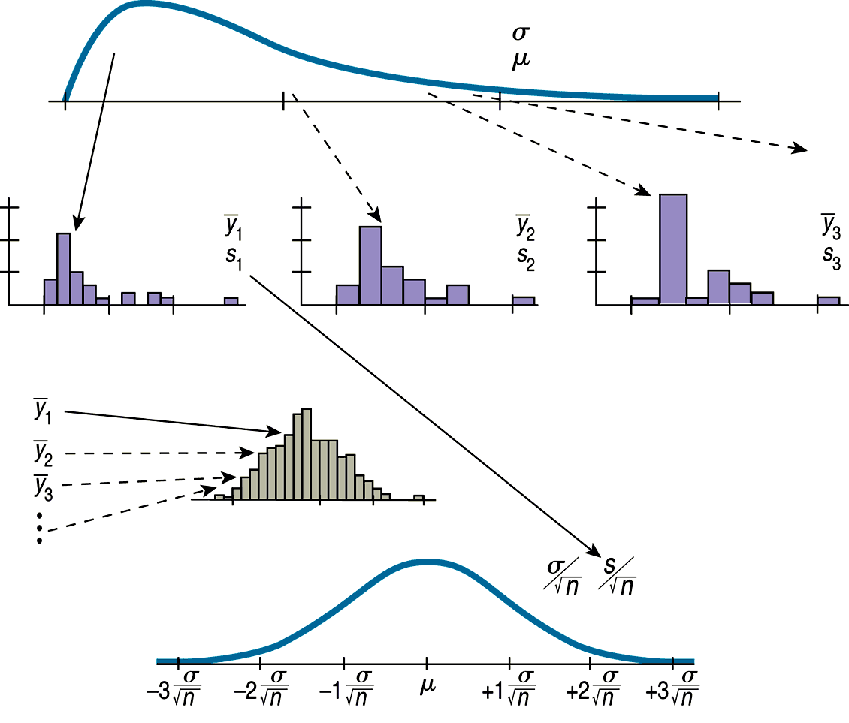
The Process Going Into the Sampling Distribution Model

Slide 46
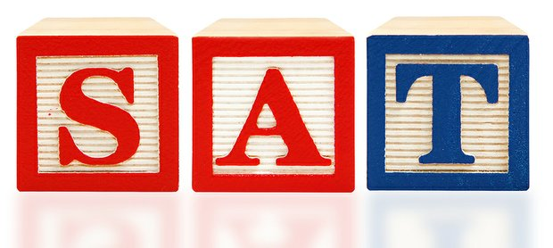
Example
SAT scores should have mean 500 and standard deviation 100. What about the mean of random samples of 20 students? (Note that the small sample is okay because we believe a Normal model applies to the population.)

Slide 47
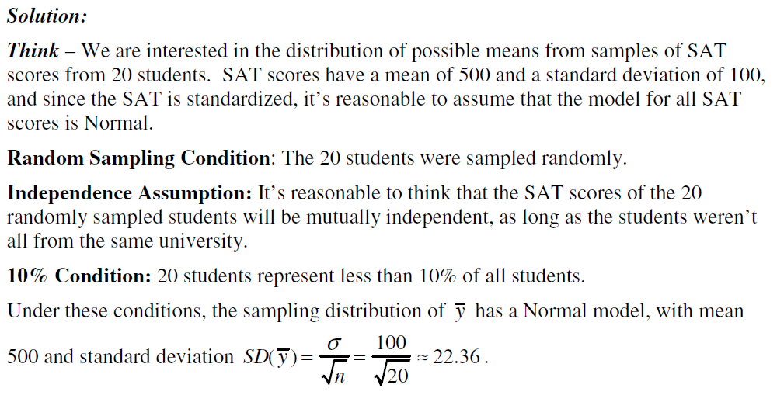
Example
SAT scores should have mean 500 and standard deviation 100. What about the mean of random samples of 20 students? (Note that the small sample is okay because we believe a Normal model applies to the population.)

Slide 48
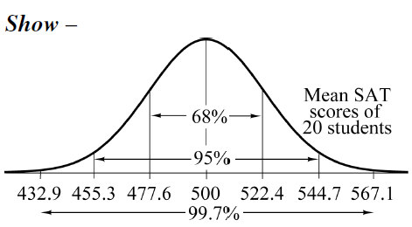
Example
SAT scores should have mean 500 and standard deviation 100. What about the mean of random samples of 20 students? (Note that the small sample is okay because we believe a Normal model applies to the population.)

Slide 49
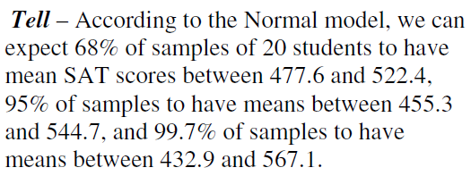
Example
SAT scores should have mean 500 and standard deviation 100. What about the mean of random samples of 20 students? (Note that the small sample is okay because we believe a Normal model applies to the population.)

Slide 50
Example
Speeds of cars on a highway have mean 52 mph and standard deviation 6 mph, and are likely to be skewed to the right (a few very fast drivers). Describe what we might see in random samples of 50 cars.

Slide 51
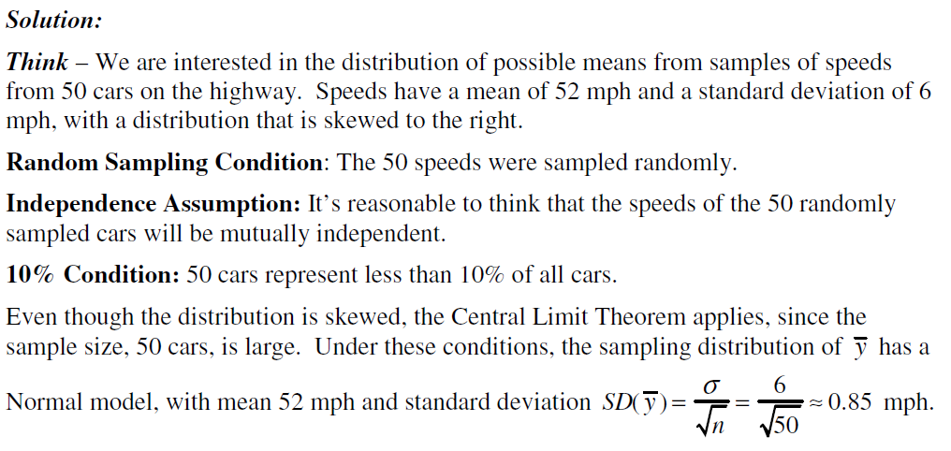
Example
Speeds of cars on a highway have mean 52 mph and standard deviation 6 mph, and are likely to be skewed to the right (a few very fast drivers). Describe what we might see in random samples of 50 cars.

Slide 52
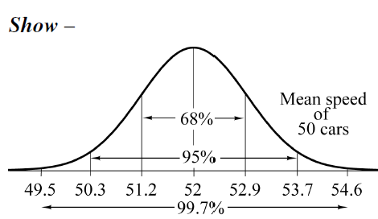
Example
Speeds of cars on a highway have mean 52 mph and standard deviation 6 mph, and are likely to be skewed to the right (a few very fast drivers). Describe what we might see in random samples of 50 cars.

Slide 53
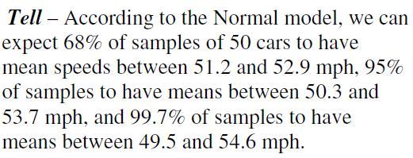
Example
Speeds of cars on a highway have mean 52 mph and standard deviation 6 mph, and are likely to be skewed to the right (a few very fast drivers). Describe what we might see in random samples of 50 cars.

Slide 54
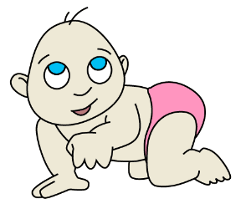
Example
At birth, babies average 7.8 pounds, with a standard deviation of 2.1 pounds. A random sample of 34 babies born to mothers living near a large factory that may be polluting the air and water shows a mean birthweight of only 7.2 pounds. Is that unusually low?

Slide 55
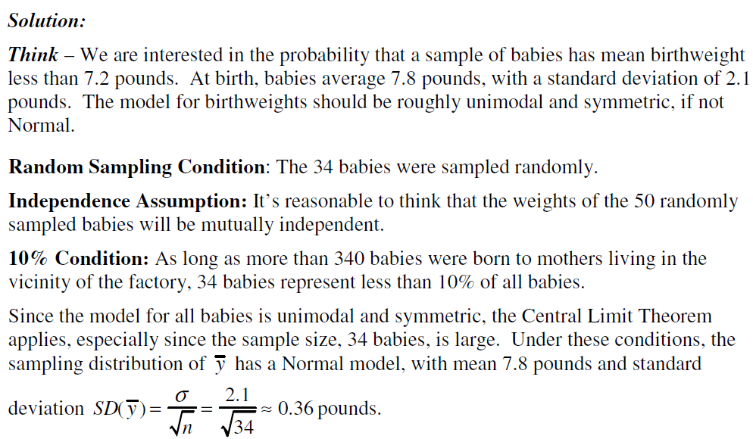
Example
At birth, babies average 7.8 pounds, with a standard deviation of 2.1 pounds. A random sample of 34 babies born to mothers living near a large factory that may be polluting the air and water shows a mean birthweight of only 7.2 pounds. Is that unusually low?

Slide 56
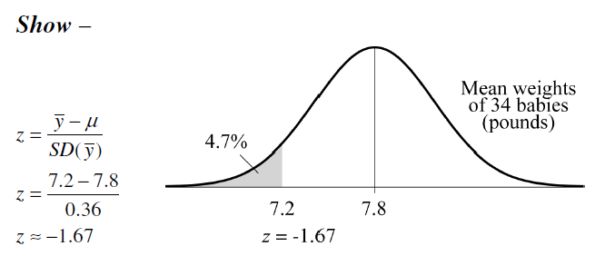
Example
At birth, babies average 7.8 pounds, with a standard deviation of 2.1 pounds. A random sample of 34 babies born to mothers living near a large factory that may be polluting the air and water shows a mean birthweight of only 7.2 pounds. Is that unusually low?

Slide 57
Example
At birth, babies average 7.8 pounds, with a standard deviation of 2.1 pounds. A random sample of 34 babies born to mothers living near a large factory that may be polluting the air and water shows a mean birthweight of only 7.2 pounds. Is that unusually low?

Slide 58
What Can Go Wrong?
Don’t confuse the sampling distribution with the distribution of the sample.
When you take a sample, you look at the distribution of the values, usually with a histogram, and you may calculate summary statistics.
The sampling distribution is an imaginary collection of the values that a statistic might have taken for all random samples—the one you got and the ones you didn’t get.

Slide 59
What Can Go Wrong?
Beware of observations that are not independent.
The CLT depends crucially on the assumption of independence.
You can’t check this with your data—you have to think about how the data were gathered.
Watch out for small samples from skewed populations.
The more skewed the distribution, the larger the sample size we need for the CLT to work.

Slide 60
What have we learned?
Sample proportions and means will vary from sample to sample—that’s sampling error (sampling variability).
Sampling variability may be unavoidable, but it is also predictable!

Slide 61
What have we learned?
We’ve learned to describe the behavior of sample proportions when our sample is random and large enough to expect at least 10 successes and failures.
We’ve also learned to describe the behavior of sample means (thanks to the CLT!) when our sample is random (and larger if our data come from a population that’s not roughly unimodal and symmetric).

Slide 62
Homework
Pages 428 – 431
2, 4, 6, 7, 11, 13, 16, 20, 23, 25, 28, 31, 33, 37, 39, 41

