Slide 1
Statistics 12
Sample Surveys

Slide 2
Background
We have learned ways to display, describe, and summarize data, but have been limited to examining the particular batch of data we have.
To make decisions, we need to go beyond the data at hand and to the world at large.
Let’s investigate three major ideas that will allow us to make this stretch…

Slide 3
Idea 1: Examine a Part of the Whole
The first idea is to draw a sample.
We’d like to know about an entire population of individuals, but examining all of them is usually impractical, if not impossible.
We settle for examining a smaller group of individuals—a sample—selected from the population.

Slide 4
Idea 1: Examine a Part of the Whole
Sampling is a natural thing to do. Think about sampling something you are cooking—you taste (examine) a small part of what you’re cooking to get an idea about the dish as a whole.

Slide 5
Idea 1: Examine Part of the Whole
Opinion polls are examples of sample surveys, designed to ask questions of a small group of people in the hope of learning something about the entire population.
Professional pollsters work quite hard to ensure that the sample they take is representative of the population.
If not, the sample can give misleading information about the population.

Slide 6
Bias
Sampling methods that, by their nature, tend to over- or under- emphasize some characteristics of the population are said to be biased.
Bias is the bane of sampling—the one thing above all to avoid.
There is usually no way to fix a biased sample and no way to salvage useful information from it.

Slide 7
Bias
The best way to avoid bias is to select individuals for the sample at random.
The value of deliberately introducing randomness is one of the great insights of Statistics.

Slide 8
Idea 2: Randomize
Randomization can protect you against factors that you know are in the data.
It can also help protect against factors you are not even aware of.
Randomizing protects us from the influences of all the features of our population, even ones that we may not have thought about.
Randomizing makes sure that on the average the sample looks like the rest of the population.

Slide 9
Randomizing
Not only does randomizing protect us from bias, it actually makes it possible for us to draw inferences about the population when we see only a sample.
Such inferences are among the most powerful things we can do with Statistics.
But remember, it’s all made possible because we deliberately choose things randomly.

Slide 10
Idea 3: It’s the Sample Size
How large a random sample do we need for the sample to be reasonably representative of the population?
It’s the size of the sample, not the size of the population, that makes the difference in sampling.
Exception: If the population is small enough and the sample is more than 10% of the whole population, the population size can matter.
The fraction of the population that you’ve sampled doesn’t matter. It’s the sample size itself that’s important.

Slide 11
Sample Size
Most people find it counterintuitive that the accuracy of survey or poll results is determined by the size of the sample regardless of the population size. By sampling 1000 voters we can estimate the outcome of an election with the same margin of error, whether it is a mayoral election in a city, a race for governor of a state, or the choice of a new president. (This is true as long as the population is much larger than the sample—if there are only 1200 voters in the city, then our sample will provide much more accurate results, of course.) How can this be?

Slide 12
Sample Size
You walk into the local ice cream shop and notice that they have a new flavor—Peanut Fudge. Sounds good, but before you buy a whole cone, you’d like a taste. They hand you a spoon and an open pint container. You scoop out one spoonful as your sample, savor the marvelous flavor, and buy an extra large cone. You base your decision on the assumption that your random spoonful is representative of all the peanut fudge ice cream the shop makes. (You chose a cluster sample randomized by the stirring process when the ice cream was made.) The servers in the ice cream shop will scoop your cone from a large 3-gallon tub. Just because that “population” is bigger won’t give you justification for a bigger sample. (Nice try, though!) And out back where they make the ice cream, they have a huge vat full of the stuff. If they let you sample from that massive population, you’d still need only a spoonful to learn what it tastes like. The issue is the size and randomness of the sample, not the size of the population.

Slide 13
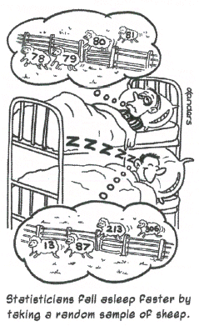

Slide 14
Does a Census Make Sense?
Why bother determining the right sample size?
Wouldn’t it be better to just include everyone and “sample” the entire population?
Such a special sample is called a census.

Slide 15
Does a Census Make Sense?
There are problems with taking a census:
It can be difficult to complete a census—there always seem to be some individuals who are hard (or expensive) to locate or hard to measure; or it may be impractical - food.
Populations rarely stand still. Even if you could take a census, the population changes while you work, so it’s never possible to get a perfect measure.
Taking a census may be more complex than sampling.

Slide 16
Populations and Parameters
Models use mathematics to represent reality.
Parameters are the key numbers in those models.
A parameter that is part of a model for a population is called a population parameter.
We use data to estimate population parameters.
Any summary found from the data is a statistic.
The statistics that estimate population parameters are called sample statistics.

Slide 17
Notation
We typically use Greek letters to denote parameters and Latin letters to denote statistics.

Slide 18
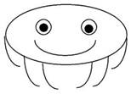
Investigation
JellyBlubbers
Supplies needed
Worksheet
Ruler

Slide 19
Investigation
JellyBlubbers
Recently discovered the colony of jellyblubbers is a new marine species.
Your task is to try to determine the average length (measured horizontally) of a blubber.

Slide 20
Investigation
JellyBlubbers
Do not turn over your worksheet until told to do so.
You will have five seconds to determine the average length of a blubber in your colony

Slide 21
Investigation
JellyBlubbers
Dot Plot of each estimate

Slide 22
Investigation
JellyBlubbers
Now randomly select 5 blubbers that you think are representative of the cology and measure each of them to determine the average length of a blubber.
Dot plot of results

Slide 23
Investigation
JellyBlubbers
Select ten numbers randomly (with calculator or table) and measure only those blubbers
Dot plot of results

Slide 24
Investigation
JellyBlubbers
Actual blubber average is 19.4 cm

Slide 25
Simple Random Samples
We draw samples because we can’t work with the entire population.
We need to be sure that the statistics we compute from the sample reflect the corresponding parameters accurately.
A sample that does this is said to be representative.

Slide 26
Simple Random Samples
We will insist that every possible sample of the size we plan to draw has an equal chance to be selected.
Such samples also guarantee that each individual has an equal chance of being selected.
With this method each combination of people has an equal chance of being selected as well.
A sample drawn in this way is called a Simple Random Sample (SRS).
An SRS is the standard against which we measure other sampling methods, and the sampling method on which the theory of working with sampled data is based.

Slide 27
Simple Random Samples
To select a sample at random, we first need to define where the sample will come from.
The sampling frame is a list of individuals from which the sample is drawn.
Once we have our sampling frame, the easiest way to choose an SRS is to assign a random number to each individual in the sampling frame.

Slide 28
Simple Random Samples
Samples drawn at random generally differ from one another.
Each draw of random numbers selects different people for our sample.
These differences lead to different values for the variables we measure.
We call these sample-to-sample differences sampling variability.

Slide 29
Stratified Sampling
Simple random sampling is not the only fair way to sample.
More complicated designs may save time or money or help avoid sampling problems.
All statistical sampling designs have in common the idea that chance, rather than human choice, is used to select the sample.

Slide 30
Stratified Sampling
Designs used to sample from large populations are often more complicated than simple random samples.
Sometimes the population is first sliced into homogeneous groups, called strata, before the sample is selected.
Then simple random sampling is used within each stratum before the results are combined.
This common sampling design is called stratified random sampling.

Slide 31
Stratified Sampling
The most important benefit is Stratifying can reduce the variability of our results.
When we restrict by strata, additional samples are more like one another, so statistics calculated for the sampled values will vary less from one sample to another.
Stratified random sampling can reduce bias.
Stratified sampling can also help us notice important differences among groups.

Slide 32
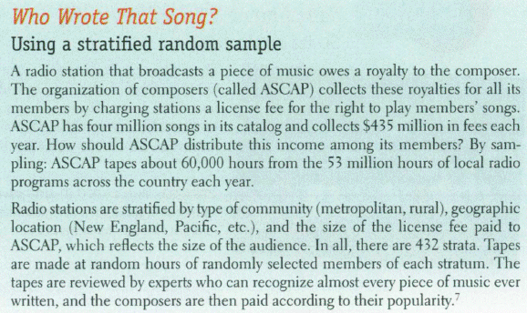
Example

Slide 33
Cluster and Multistage Sampling
Sometimes stratifying isn’t practical and simple random sampling is difficult.
Splitting the population into similar parts or clusters can make sampling more practical.
Then we could select one or a few clusters at random and perform a census within each of them.
This sampling design is called cluster sampling.
If each cluster fairly represents the full population, cluster sampling will give us an unbiased sample.

Slide 34
Cluster and Multistage Sampling
Cluster sampling is not the same as stratified sampling.
We stratify to ensure that our sample represents different groups in the population, and sample randomly within each stratum.
Strata are internally homogeneous, but differ from one another.
Clusters are more or less alike, are internally heterogeneous and each resembling the overall population.
We select clusters to make sampling more practical or affordable.

Slide 35
Cluster and Multistage Sampling
Sometimes we use a variety of sampling methods together.
Sampling schemes that combine several methods are called multistage samples.
Most surveys conducted by professional polling organizations use some combination of stratified and cluster sampling as well as simple random sampling.

Slide 36
Systematic Samples
Sometimes we draw a sample by selecting individuals systematically.
For example, you might survey every 10th person on an alphabetical list of students.
To make it random, you must still start the systematic selection from a randomly selected individual.
When there is no reason to believe that the order of the list could be associated in any way with the responses sought, systematic sampling can give a representative sample.

Slide 37
Systematic Samples
Systematic sampling can be much less expensive than true random sampling.
When you use a systematic sample, you need to justify the assumption that the systematic method is not associated with any of the measured variables.

Slide 38
Defining the “Who”
The Who of a survey can refer to different groups, and the resulting ambiguity can tell you a lot about the success of a study.
To start, think about the population of interest. Often, you’ll find that this is not really a well-defined group.
Even if the population is clear, it may not be a practical group to study.

Slide 39
Defining the “Who”
Second, you must specify the sampling frame.
Usually, the sampling frame is not the group you really want to know about.
The sampling frame limits what your survey can find out.

Slide 40
Defining the “Who”
Then there’s your target sample.
These are the individuals for whom you intend to measure responses.
You’re not likely to get responses from all of them. Nonresponse is a problem in many surveys.

Slide 41
Defining the “Who”
Finally, there is your sample—the actual respondents.
These are the individuals about whom you do get data and can draw conclusions.
Unfortunately, they might not be representative of the sample, the sampling frame, or the population.

Slide 42
Defining the “Who”
At each step, the group we can study may be constrained further.
The Who keeps changing, and each constraint can introduce biases.
A careful study should address the question of how well each group matches the population of interest.

Slide 43
Defining the “Who”
One of the main benefits of simple random sampling is that it never loses its sense of who’s Who.
The Who in a SRS is the population of interest from which we’ve drawn a representative sample. (That’s not always true for other kinds of samples.)

Slide 44
Brainstorming
List ways that a sample could be biased

Slide 45
Brainstorming
List ways that a sample could be biased
undercoverage
judgment sample
convenience sample
voluntary response
nonresponse
response bias

Slide 46
Sample Bias

Slide 47
Example
How could you get an SRS of the students at school? How about stratified or cluster samples? Or a systematic sample?

Slide 48
Example
How could you get an SRS of the students at school?
To obtain an SRS of the students at school, you could number the names in the student directory, and choose your sample by generating random numbers and matching the numbers with the students in your sample. This may raise some issues, however. Are all students included in the directory? If not, do the students excluded differ in any systematic way from the students in the directory?

Slide 49
Example
How about stratified or cluster samples?
A stratified sample may consist of a certain number each of freshman, sophomores, juniors, and seniors. Other strata may be males and females, athletes and non-athletes, or any other groupings that you feel would decrease variability in each stratum.
You might choose a cluster sample by choosing a homeroom at random, and sampling each student in that homeroom, or choosing a class at random and sampling all of the students in that class.

Slide 50
Example
How about a systematic sample?
A systematic sample could be obtained from a list of all students at the school. Suppose you want to sample 50 students from a school of 500. Number the students 001 to 500. Generate a random number from 001 to 010, and start with that student. Every 10th student in the list becomes part of your sample.

Slide 51
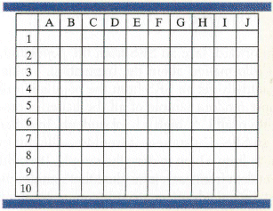
Activity
A British farmer grows sunflowers for making sunflower oil. Her field is arranged in a grid pattern, with 10 rows and 10 columns as shown. Irrigation ditches run along the top and bottom of the field as shown. The farmer would like to estimate the number of healthy plants in the field so she can project how much money she’ll make from selling them. It would take too much time to count the plants in all 100 squares, so she’ll accept an estimate based on a sample of ten squares.

Slide 52
Activity
Use technology to take a simple random sample of 10 grid squares. Record the location of each square you select

Slide 53
Activity
Take a stratified random sample using the rows as the strata. Use technology to randomly select one square from each horizontal row. Record the location of each square

Slide 54
Activity
Now, take a stratified random sample using the columns as strata. Record the location of each square

Slide 55
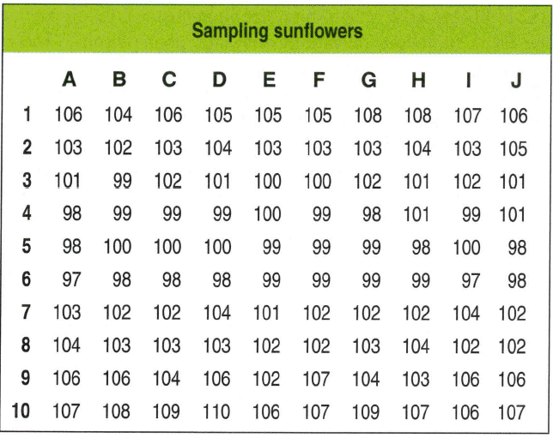
Activity
Use the table to calculate your estimate from each of the three preceding methods

Slide 56
The Valid Survey
It isn’t sufficient to just draw a sample and start asking questions. A valid survey yields the information we are seeking about the population we are interested in. Before you set out to survey, ask yourself:
What do I want to know?
Am I asking the right respondents?
Am I asking the right questions?
What would I do with the answers if I had them; would they address the things I want to know?

Slide 57
The Valid Survey
These questions may sound obvious, but there are a number of pitfalls to avoid.
Know what you want to know.
Understand what you hope to learn and from whom you hope to learn it.
Use the right frame.
Be sure you have a suitable sampling frame.
Tune your instrument.
The survey instrument itself can be the source of errors - too long yields less responses.

Slide 58
The Valid Survey
Ask specific rather than general questions.
Ask for quantitative results when possible.
Be careful in phrasing questions.
A respondent may not understand the question or may understand the question differently than the way the researcher intended it.
Even subtle differences in phrasing can make a difference.

Slide 59
The Valid Survey
Be careful in phrasing answers.
It’s often a better idea to offer choices rather than inviting a free response.

Slide 60
The Valid Survey
The best way to protect a survey from unanticipated measurement errors is to perform a pilot survey.
A pilot is a trial run of a survey you eventually plan to give to a larger group.

Slide 62
What Can Go Wrong?—or, How to Sample Badly
Sample Badly with Volunteers:
In a voluntary response sample, a large group of individuals is invited to respond, and all who do respond are counted.
Voluntary response samples are almost always biased, and so conclusions drawn from them are almost always wrong.
Voluntary response samples are often biased toward those with strong opinions or those who are strongly motivated.
Since the sample is not representative, the resulting voluntary response bias invalidates the survey.

Slide 63
What Can Go Wrong?—or, How to Sample Badly
Sample Badly, but Conveniently:
In convenience sampling, we simply include the individuals who are convenient.
Unfortunately, this group may not be representative of the population.
Convenience sampling is not only a problem for students or other beginning samplers.
In fact, it is a widespread problem in the business world—the easiest people for a company to sample are its own customers.

Slide 64
What Can Go Wrong?—or, How to Sample Badly
Sample from a Bad Sampling Frame:
An SRS from an incomplete sampling frame introduces bias because the individuals included may differ from the ones not in the frame.
Undercoverage:
Many of these bad survey designs suffer from undercoverage, in which some portion of the population is not sampled at all or has a smaller representation in the sample than it has in the population.
Undercoverage can arise for a number of reasons, but it’s always a potential source of bias.

Slide 65
What Else Can Go Wrong?
Watch out for nonrespondents.
A common and serious potential source of bias for most surveys is nonresponse bias.
No survey succeeds in getting responses from everyone.
The problem is that those who don’t respond may differ from those who do.
And they may differ on just the variables we care about.

Slide 66
What Else Can Go Wrong?
Don’t bore respondents with surveys that go on and on and on and on…
Surveys that are too long are more likely to be refused, reducing the response rate and biasing all the results.

Slide 67
What Else Can Go Wrong?
Work hard to avoid influencing responses.
Response bias refers to anything in the survey design that influences the responses.
For example, the wording of a question can influence the responses:

Slide 68
How to Think About Biases
Look for biases in any survey you encounter before you collect the data—there’s no way to recover from a biased sample of a survey that asks biased questions.
Spend your time and resources reducing biases.
If you possibly can, pilot-test your survey.
Always report your sampling methods in detail.

Slide 69
What have we learned?
A representative sample can offer us important insights about populations.
It’s the size of the same, not its fraction of the larger population, that determines the precision of the statistics it yields.
There are several ways to draw samples, all based on the power of randomness to make them representative of the population of interest:
Simple Random Sample, Stratified Sample, Cluster Sample, Systematic Sample, Multistage Sample

Slide 70
What have we learned?
Bias can destroy our ability to gain insights from our sample:
Nonresponse bias can arise when sampled individuals will not or cannot respond.
Response bias arises when respondents’ answers might be affected by external influences, such as question wording or interviewer behavior.

Slide 71
What have we learned?
Bias can also arise from poor sampling methods:
Voluntary response samples are almost always biased and should be avoided and distrusted.
Convenience samples are likely to be flawed for similar reasons.
Even with a reasonable design, sample frames may not be representative.
Undercoverage occurs when individuals from a subgroup of the population are selected less often than they should be.

Slide 72
What have we learned?
Finally, we must look for biases in any survey we find and be sure to report our methods whenever we perform a survey so that others can evaluate the fairness and accuracy of our results.

Slide 73
Homework
Pages 289 – 292
2, 3, 5, 8, 13, 16, 17, 18, 20, 26, 28, 32

