Slide 1
Robotics IQ
Engineering drawing

Slide 2
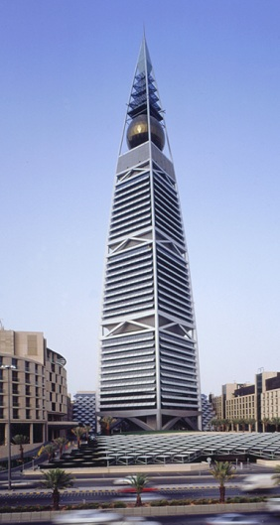
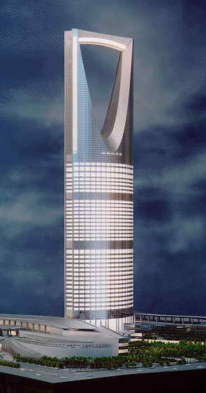
Drawing
Graphic Language & Effectiveness
Try writing the description of these pictures……………

Slide 3
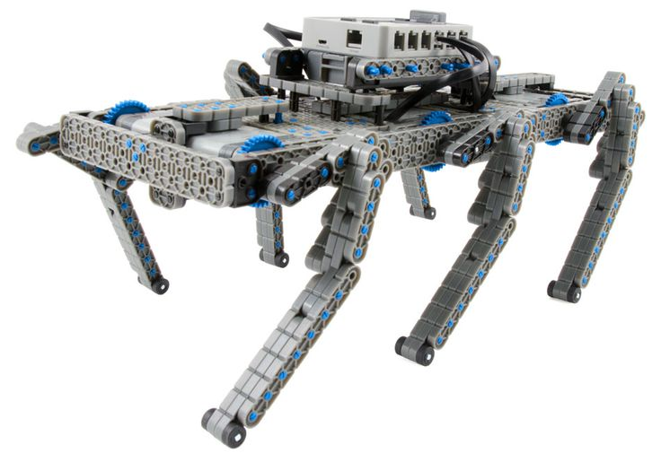
Drawing
Or this
And let someone attempt to make a sketch or visualize from your description.

Slide 4
Drawing
Graphic Language & Effectiveness
It can be found that …
The word language is
inadequate
for describing the
size, shape and features
completely as well as concisely.

Slide 5
Design Process
Visualization
is the ability to mentally picture things that do not exist
Visualize
Problem identification
& exploration of ideas
Draw , design and record initial ideas
Communication
the design solution should be communicated to others without ambiguity
Sketches
Created from sketches
used or analysis
Geometric model
Refine, optimize
& record the precise data for production process or implementation
Detail drawings
&
3D model
Documentation
permanent record of the solution

Slide 6
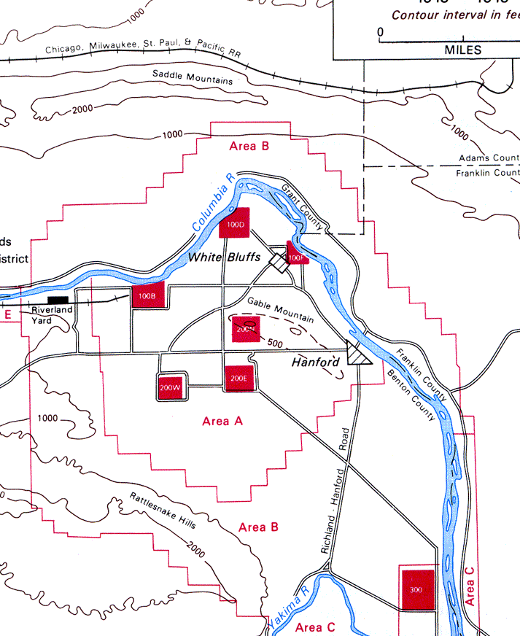
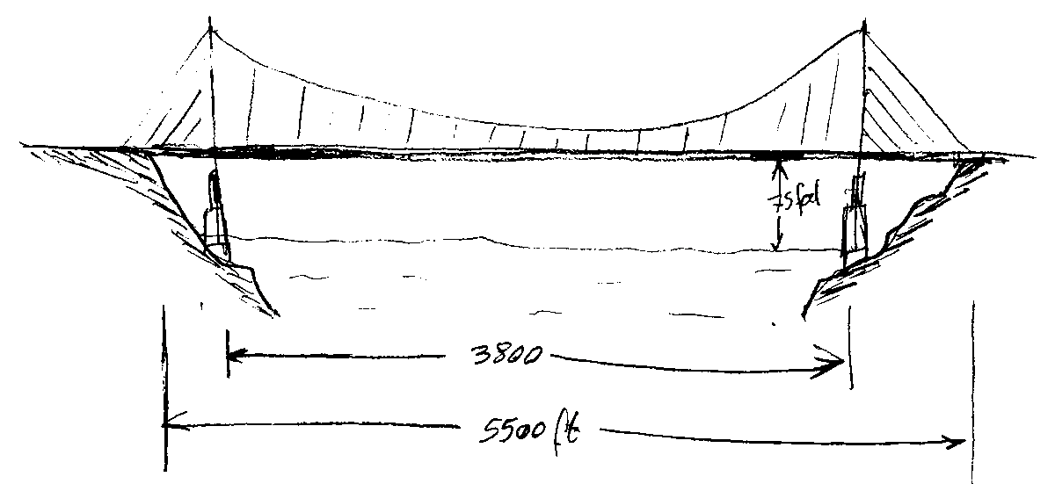
Design Process
Problem Definition
Visualize
Exploration of Ideas
Sketches
Design
Geometric
model
Analysis
Refinement and Optimization
Detail drawings
& 3D model
Implementation

Slide 7
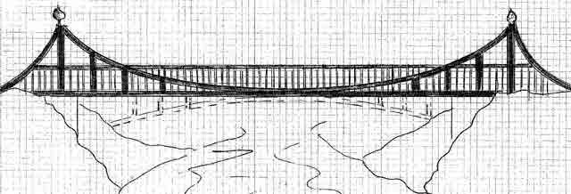
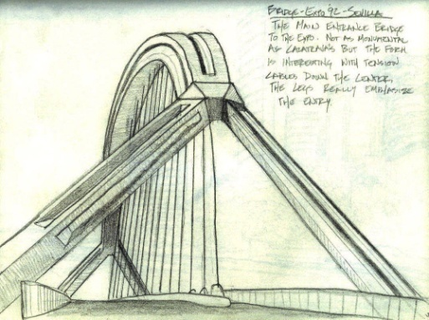
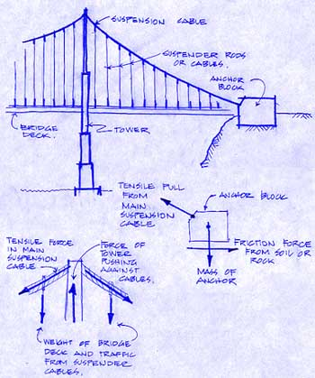
Design Process
Problem Definition
Visualize
Exploration of Ideas
Sketches
Design
Geometric
model
Analysis
Refinement and Optimization
Detail drawings
& 3D model
Implementation

Slide 8
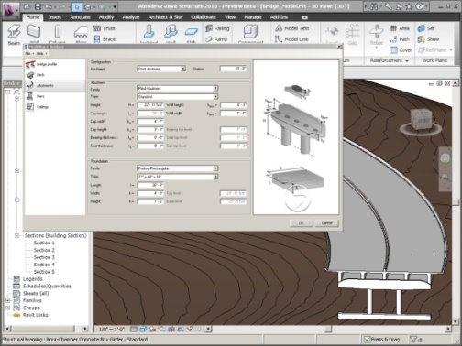
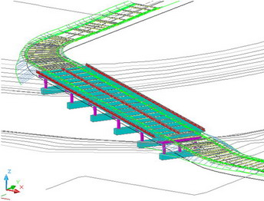
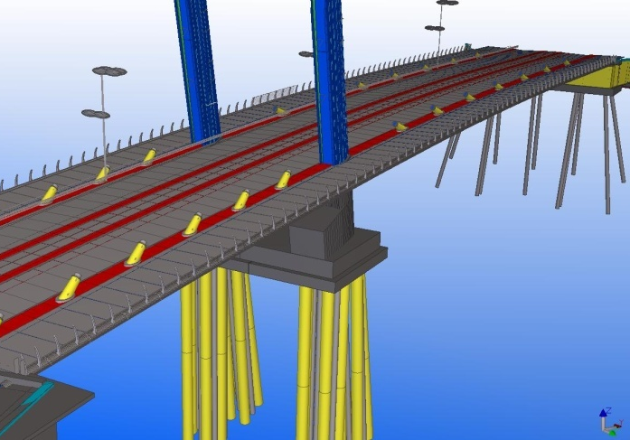
Design Process
Problem Definition
Visualize
Exploration of Ideas
Sketches
Design
Geometric
model
Analysis
Refinement and Optimization
Detail drawings
& 3D model
Implementation

Slide 9
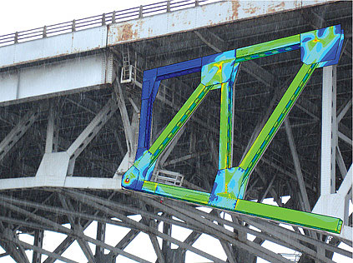
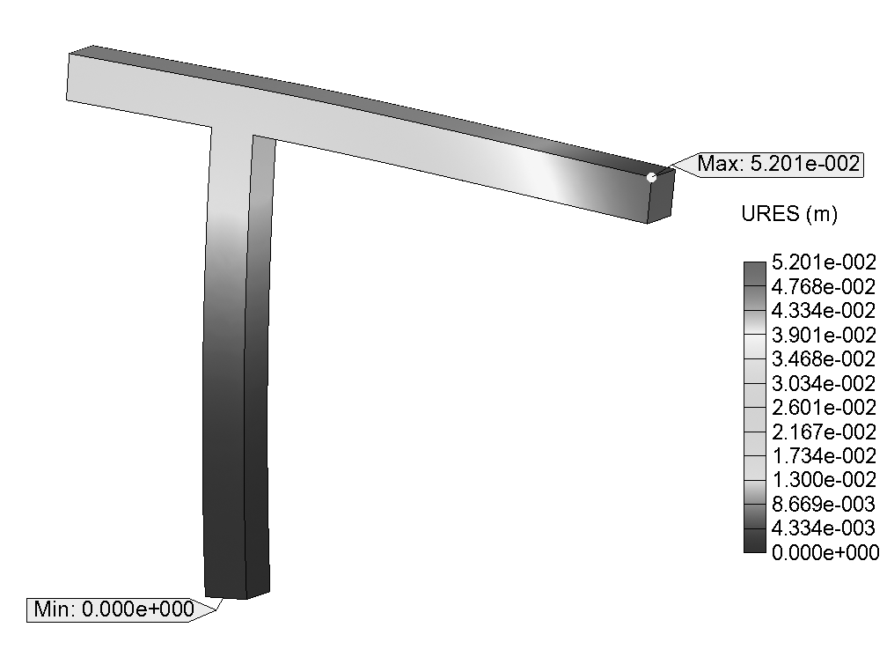
Design Process
Problem Definition
Visualize
Exploration of Ideas
Sketches
Design
Geometric
model
Analysis
Refinement and Optimization
Detail drawings
& 3D model
Implementation

Slide 10
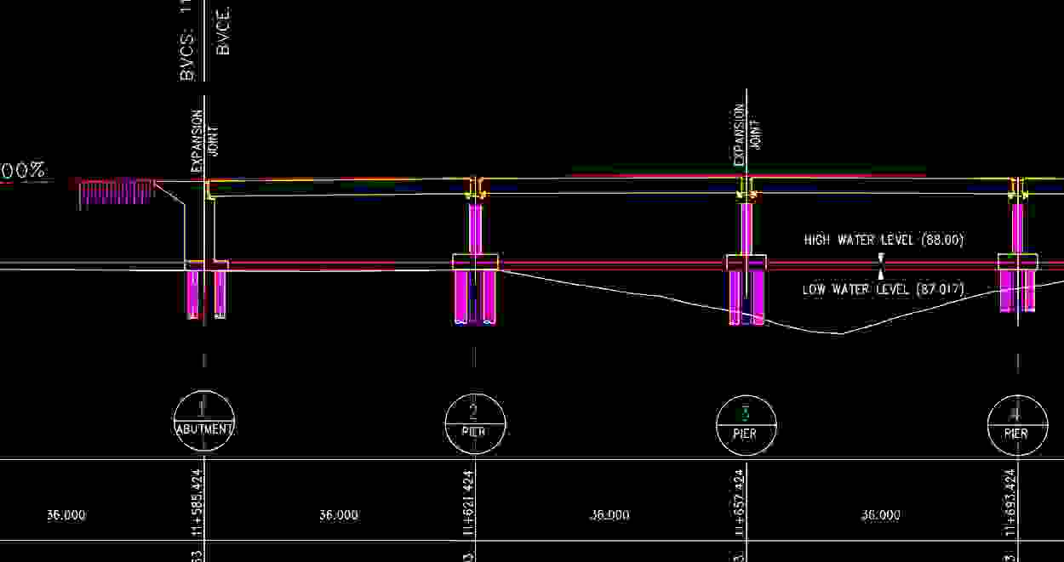
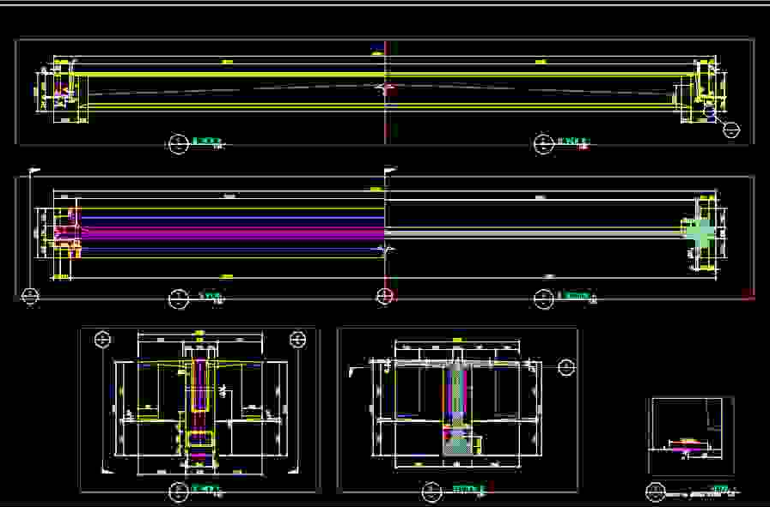
Drawing
Problem Definition
Visualize
Exploration of Ideas
Sketches
Design
Geometric
model
Analysis
Refinement and Optimization
Detail drawings
& 3D model
Implementation

Slide 11
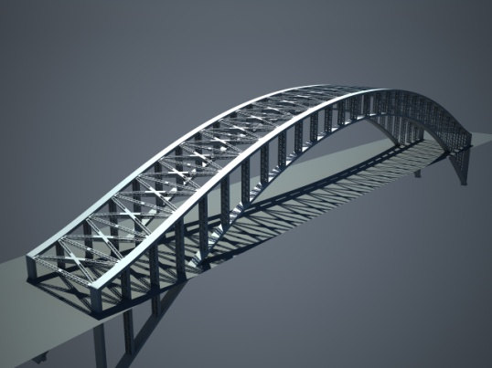
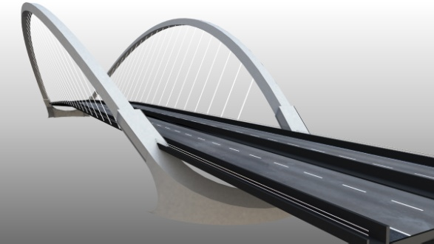
Drawing
Problem Definition
Visualize
Exploration of Ideas
Sketches
Design
Geometric
model
Analysis
Refinement and Optimization
Detail drawings
& 3D model
Implementation

Slide 12
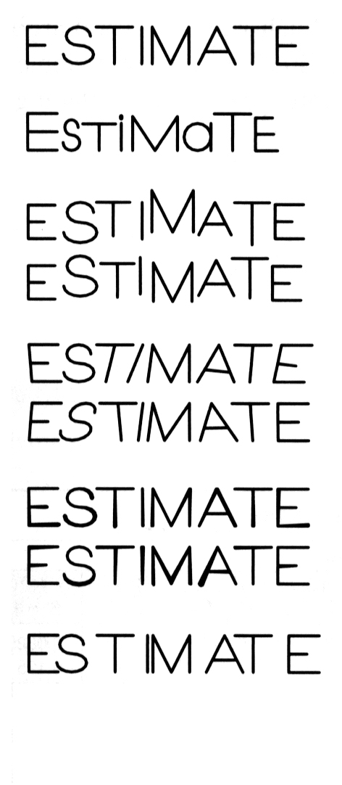
Drawing
Text’s style on the drawing
must have the following
2 properties
Examples
GOOD
Not uniform in style.
Legibility
- Shape
Space between letters
Space between words
Not uniform in height.
Not uniformly vertical.
Uniformity
Not uniform in
thickness of stroke.
- Size (or text height) - line thickness
Inappropriate space
between letters

Slide 13
Drawing
Basic Strokes
Straight
Slanted
Horizontal
Curved
Examples
“I” letter
“A” letter
“B” letter
4
5
1
1
2
1
3
6
3
2

Slide 14
Drawing

Slide 15
Drawing
Leave the space between words equal to the space requires for writing a letter “O”.
Example
ALL
O
DIMENSIONS
O
ARE
O
IN
MILLIMETERS
O
UNLESS
OTHERWISE
O
SPECIFIED.

Slide 16
Writing
Everyone write out the whole alphabet

Slide 17
Writing
Everyone write your name neatly

Slide 18
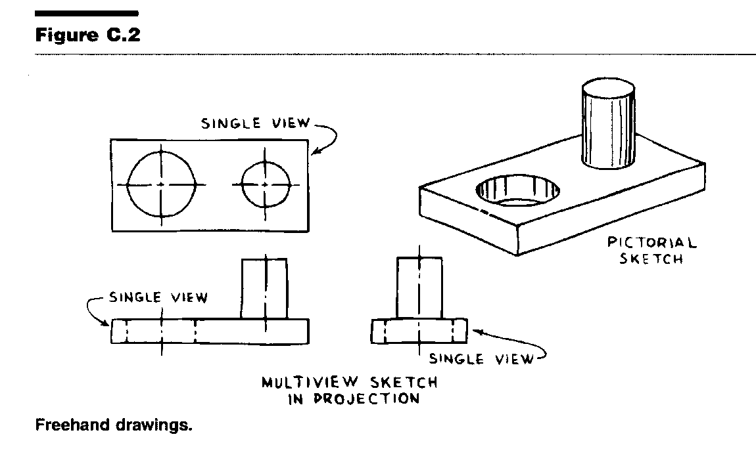
Drawing
Sketching
Drawings made without mechanical drawing tools
Free-Hand
Ruler
Simple drawing program
Should follow standards and conventions
From Course Text

Slide 19
Drawing
Basic Line Types &Application
Thickness
Thick
Thin
1. Dimension line
2. Extension line
3. Leader line
Style
Visible line
Continuous
Hidden line
Dash
Chain
Center line
1. Visible line
represent features that can be seen in the current view.
2. Dimension line
Extension line
Leader line
indicate the sizes and location of features.
3. Hidden line
represent features that can not be seen in the current view.
represents symmetry, path of motion, centers of circles,
axis of axisymmetrical parts
4. Center line

Slide 20
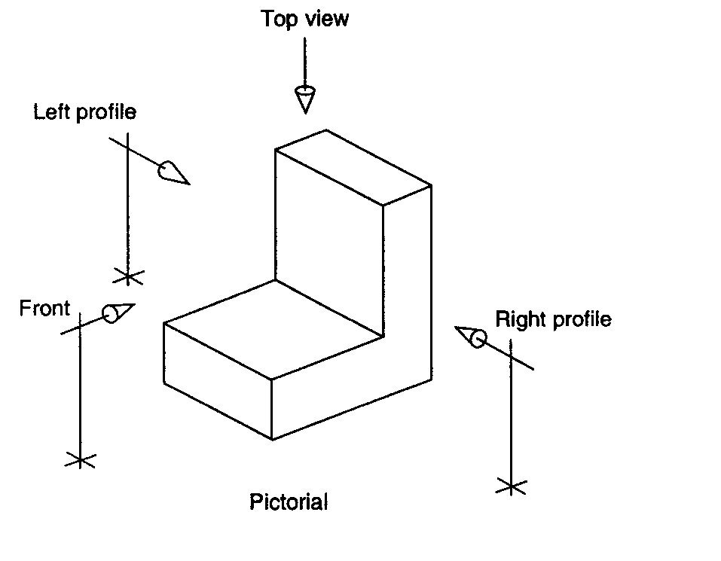
Isometric Drawing

Slide 21
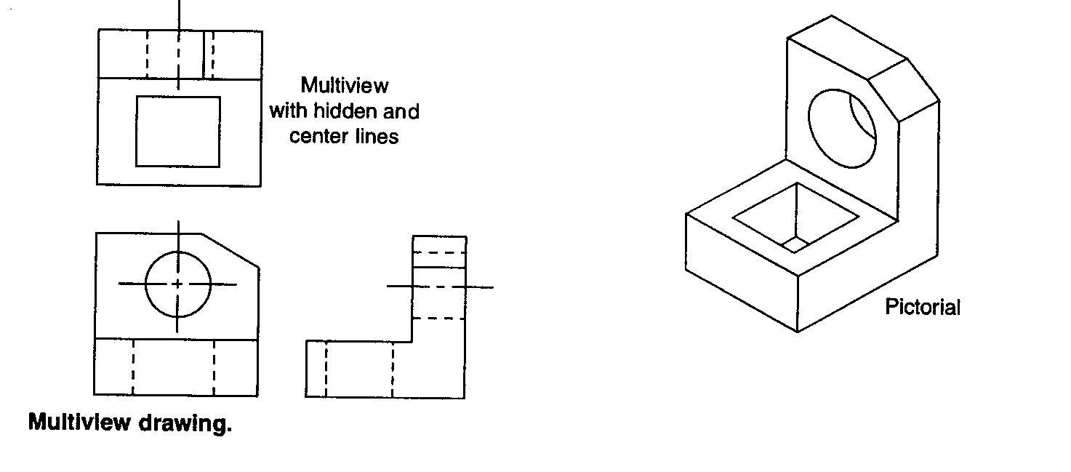
Drawing
Orthographic / Multiview
Draw object from two / three perpendicular views
What it looks like isometrically
/ Orthographic

Slide 22
Sketching Tips
1. Don’t grip the pencil too tightly.
2. Keep developmental lines light.
3. Darken object lines when your drawing is complete.
4. Maintain proper proportion.
5. Keep your drawings neat.

Slide 23
Exercise
Sketch Exercise
Begin with a blank page in your notebook.
Sketch a small square in the middle of the paper.
Sketch another square around the first square.
Maintain an equal distance between squares

Slide 24
Exercise

Slide 25
Exercise
Sketching Proportionally Correct Curves and Circles
You do not have to be an artist to accurately and neatly lay out your ideas using technical sketching methods.
A good example of layout is demonstrated at the right - laying out a circle.
A circle fits perfectly into a square. In order to draw proportionally correct circles, use the following sequence:
1. Begin by sketching a square.
2. Divide the square into four even areas.
3.- 6. Complete the four semi-circles.
Note: Remember to keep all of your lines light. Darken your lines when the sketch is correct

Slide 26
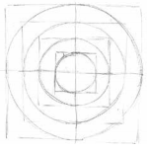
Exercise

Slide 27
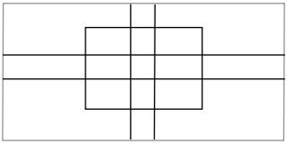
Exercise
Sketch the shape shown

Slide 28
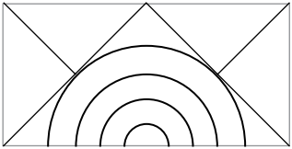
Exercise
Sketch the shape shown

Slide 29
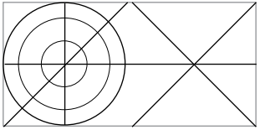
Exercise
Sketch the shape shown

Slide 30
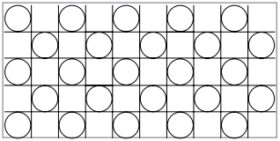
Exercise
Sketch the shape shown

Slide 31
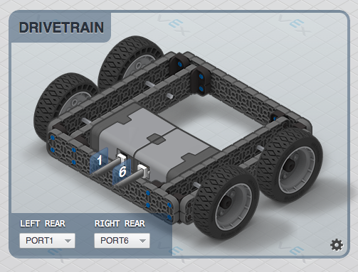
Sketching

