Slide 1
VEX IQ – Agility
Agility Challenge

Slide 2
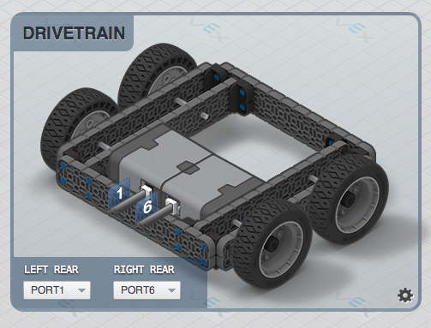
Agility Challenge
Goal – to build different style drive bases, and test each one to see how why they work differently, and which to design into a robot in the future

Slide 3
Agility Challenge
To make the “test” fair, each wheel will be driven directly by exactly one motor. NO GEARS
Each team must build four robots (one at a time) and test each.
Testing includes driving through an agility course, each team member must complete the course twice, once with each drive style program

Slide 4
Agility Challenge
Tank Drive
Each joystick controls one side of the robot
This is what we have used so far in class
Each joystick only registers for moving forward or backward
Arcade Drive
One joystick works for everything
Moving joystick to the right alters wheel speed to cause robot to turn that direction

Slide 5
Agility Challenge
Different drive bases are
Skinny and Long
Wide and short
Tiny
Huge

Slide 6
Agility Challenge
Skinny and Long
Wheels as close together as possible – Length of motors is the limit here, backs of motors should touch
Longest beam used for robot length

Slide 7
Agility Challenge
Wide and Short
Build this one as wide as you can
The front and back wheels should almost touch

Slide 8
Agility Challenge
Tiny
This is a small robot all around
As narrow as can be built with backs of motors touching
Wheels should be very close to each other from front to back

Slide 9
Agility Challenge
Huge
Make it as wide and as long as possible
Bonus for the team with longest and widest!

Slide 10
Agility Challenge
Notebook
Document your builds, and record all your times in the agility challenge
When you have built all four robots, your team will have a chance to build a fifth robot with your style, but motors to wheels are still one-to-one

Slide 11
Agility Challenge
Build quality/style
You are free to build the agility robot of your dreams, however, it better not leave any robot parts on the field. No times are counted if a part falls off your robot.

Slide 12
Agility Challenge
Fifth robot
Fastest robot through the challenge course wins. Times will be posted, and teams will be able to re-build up until the last day, Sept 21st.

Slide 13
Agility Challenge
Teams
A – Bryce, Jacques, Jake
B – Dawson, Ethan, Jackson
C – James, Jason, Noble
D- Brock, Cole, Laurel
E – Allana, Brodie, David

