Slide 1
Vex IQ Quarter 1 end
TAG

Slide 2
TAG
You have the ability to build the robot however you want, including motors and wheels and gears.
Groups brainstorm first and produce a basic drawing before they may begin to build

Slide 3
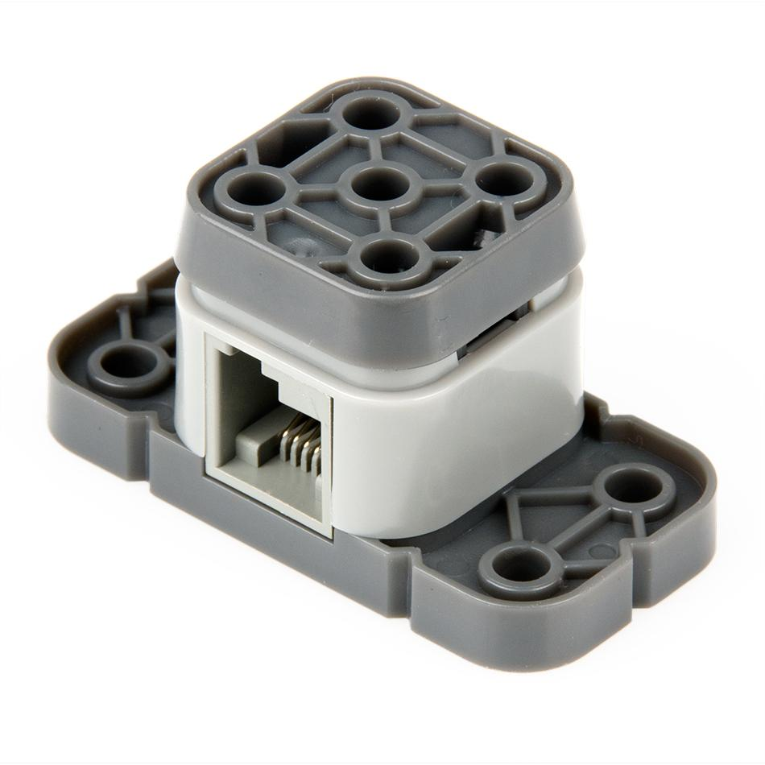
TAG
Rules
Each robot must include a bumper switch on the front or back of the robot. This switch may not be blocked in any way, it must be the most forward item on the robot.

Slide 4
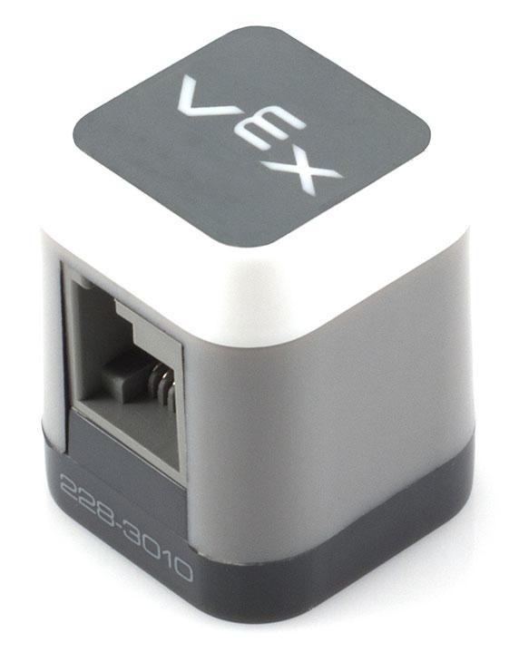
TAG
Rules
Each robot must include a LED on the top of the robot. This should be easily visible to all spectators. It will change colors from green to red when the bumper switch is pushed. The robot wheels will also stop working.

Slide 5
Schedule
We will have three rounds of tag matches. Between each round, teams will have a chance to re-build their robot so that it is better than their last robot and better able to compete.
This project ends the first quarter.

Slide 6
Wiring
Wire the robot as follows – Write this in notebooks for future reference!
1 – Left Front Wheel
2 – Left Rear Wheel
3 – Touch LED
4 – Bumper Switch
5 – Right Front
6 – Right Rear

Slide 7
Groups
A: Allana, Brock, Noble
B: Bryce, Dawson, Jason
C: Brodie, Cole, James
D: David, Jackson, Laurel
E: Ethan, Jacques, Jake

